Slide 1

FailFirst: Gamified C++ Learning Application
By AayusX
AayusX – FailFirst Project

Slide 2

What is FailFirst?
FailFirst is an innovative desktop application designed to transform how students learn C++ programming. It moves beyond traditional theoretical instruction, focusing on practical application and engagement.
Desktop-based Learning
A dedicated application providing a focused learning environment.
Practice-Oriented Approach
Learn effectively through hands-on practice, not just passive reading.
Interactive Challenges
Engage with quizzes, buggy-code scenarios, and narrative-driven challenges.
AayusX – FailFirst Project

Slide 3

Why This Project?
Traditional programming education often overlooks critical psychological and pedagogical barriers for beginners. FailFirst addresses these head-on.
Fear of Mistakes: Beginners often hesitate to experiment due to the fear of errors, hindering their learning process.
Debugging Complexity: The crucial skill of debugging is frequently perceived as overly difficult and frustrating.
Engagement Gap: Conventional learning methods can feel monotonous, leading to decreased motivation and retention.
FailFirst ingeniously transforms errors into valuable learning opportunities, fostering a growth mindset.
AayusX – FailFirst Project

Slide 4

Core Technologies Utilised
The development of FailFirst leveraged a robust stack of modern programming languages and frameworks, ensuring a stable, scalable, and user-friendly application.
C++ (C++17)
Qt 6 Framework
The primary language, chosen for its performance, power, and industry relevance.
For building the cross-platform graphical user interface (GUI), ensuring a native look and feel across different operating systems.
SQLite Database
CMake Build System
An embedded relational database system for efficient, local storage and management of user data and learning progress.
Used for managing the compilation process, ensuring project portability and maintainability.
AayusX – FailFirst Project

Slide 5

The Learning Journey: How FailFirst Works
FailFirst guides learners through a structured, yet flexible, pathway designed to maximise engagement and knowledge retention.
Choose a Lesson
Login or Register
Solve a Challenge
Earn XP
Select a guided topic or module
Unlock progress and rewards
Access your personalized learning
Tackle tasks with intentional failure
This intuitive process ensures a seamless and rewarding experience, where every successful step contributes to the user's progress and understanding.
AayusX – FailFirst Project

Slide 6





Key Features for Enhanced Learning
FailFirst integrates several unique features to make learning C++ both effective and enjoyable.
Gamification
Offline Desktop App
Persistent Progress
Earn XP (experience points) and build streaks to track progress and stay motivated.
Learn anywhere, anytime, without requiring an internet connection.
All user progress is securely saved, allowing for continuous learning sessions.
Modular Design
Easily expand the application with new lessons and challenge types.
AayusX – FailFirst Project

Slide 7
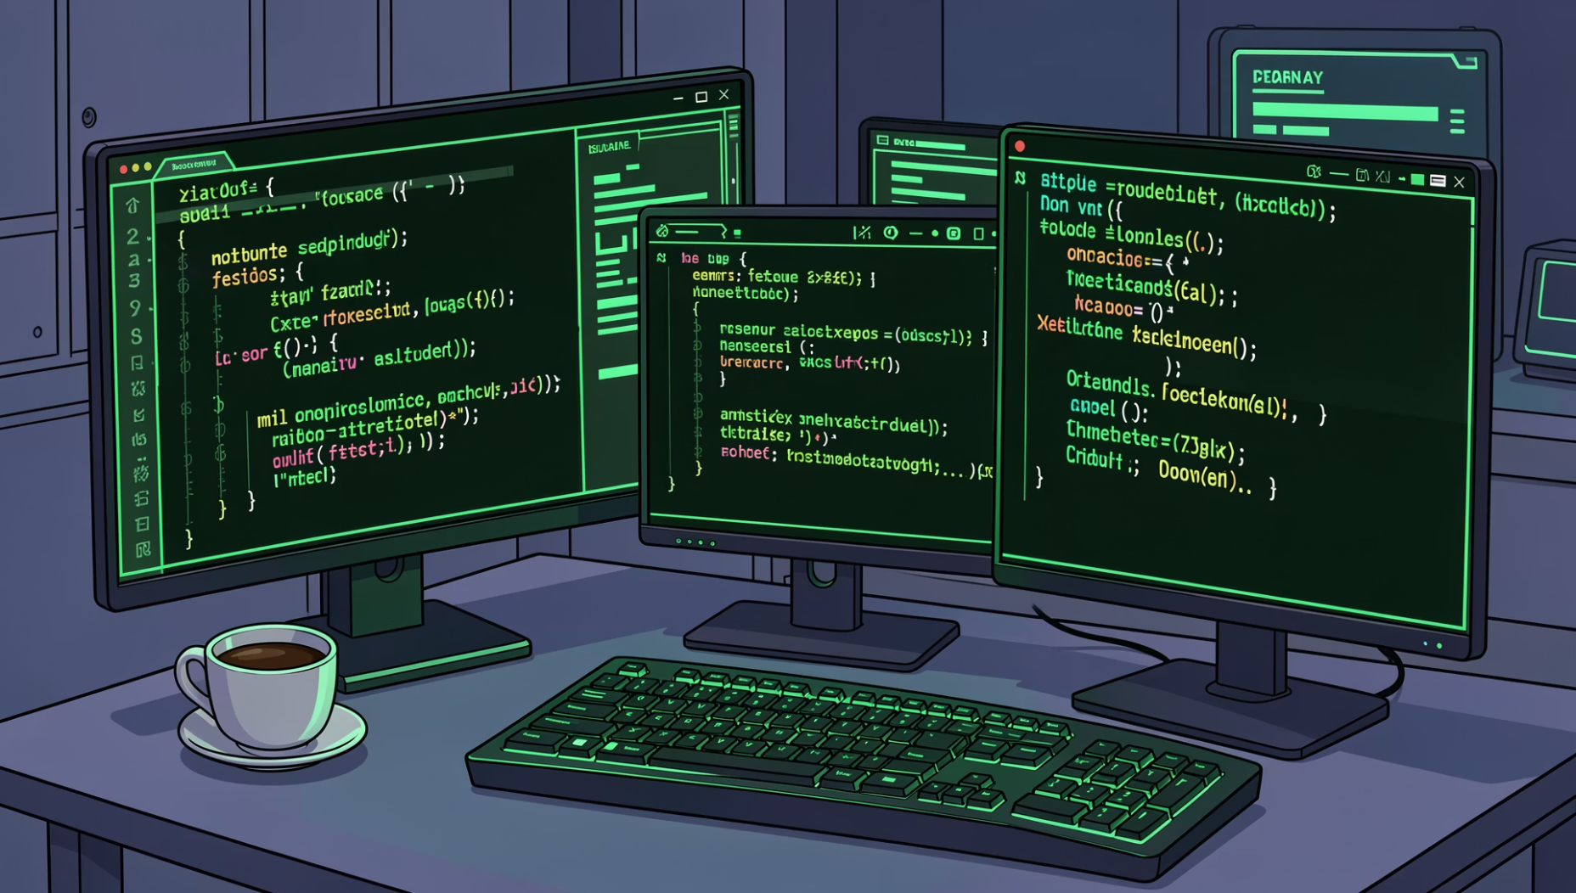
Personal Growth: What I Learned
The development of FailFirst was a significant learning experience, solidifying numerous advanced programming concepts and practical skills.
C++ Object-Oriented Programming (OOP)
Qt Framework Mastery
Database Integration
Software Architecture Principles
Implemented robust data storage solutions using SQLite, including schema design and query optimisation.
Deepened understanding of classes, inheritance, polymorphism, and design patterns.
Gained proficiency in GUI design, event handling, and cross-platform development with Qt 6.
Applied best practices in designing scalable, maintainable, and efficient software systems.
AayusX – FailFirst Project

Slide 8

Conclusion: The Future of Learning C++
FailFirst represents more than just an application; it's a paradigm shift in programming education.
A Practical Learning Tool
Encourages "Learning by Doing"
Successfully bridges the gap between theoretical knowledge and practical application, empowering new programmers.
Fosters an environment where experimentation and problem-solving are celebrated, accelerating skill development.
Strong Future Potential
With its modular design and engaging approach, FailFirst is poised for continuous development and impact on the C++ learning community.
AayusX – FailFirst Project

Slide 9

AayusX – FailFirst Project

